Slide 1
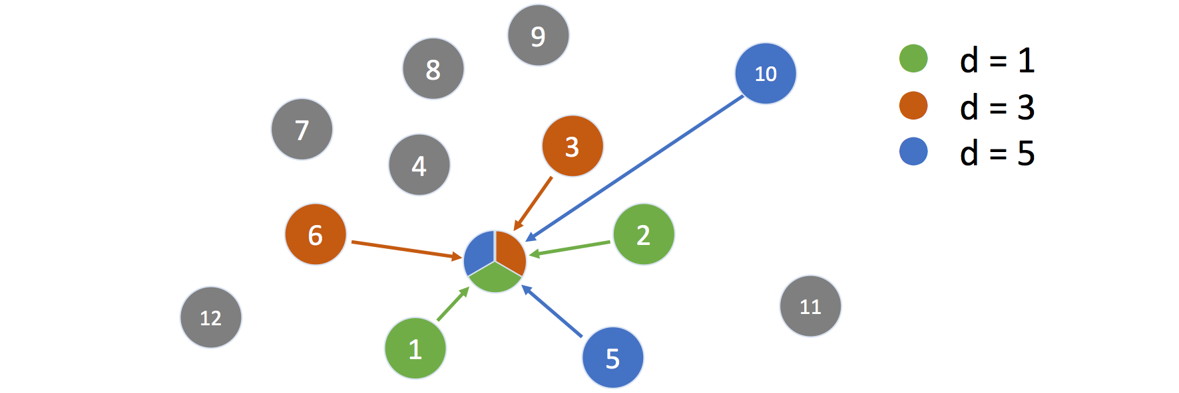
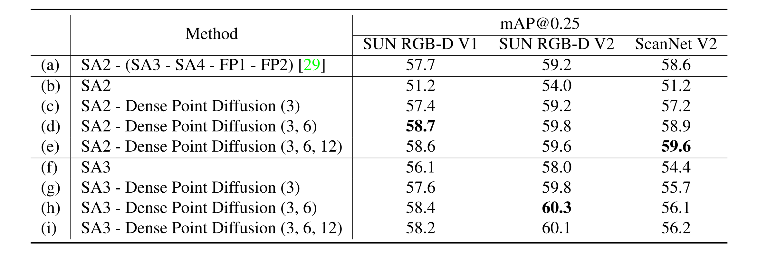
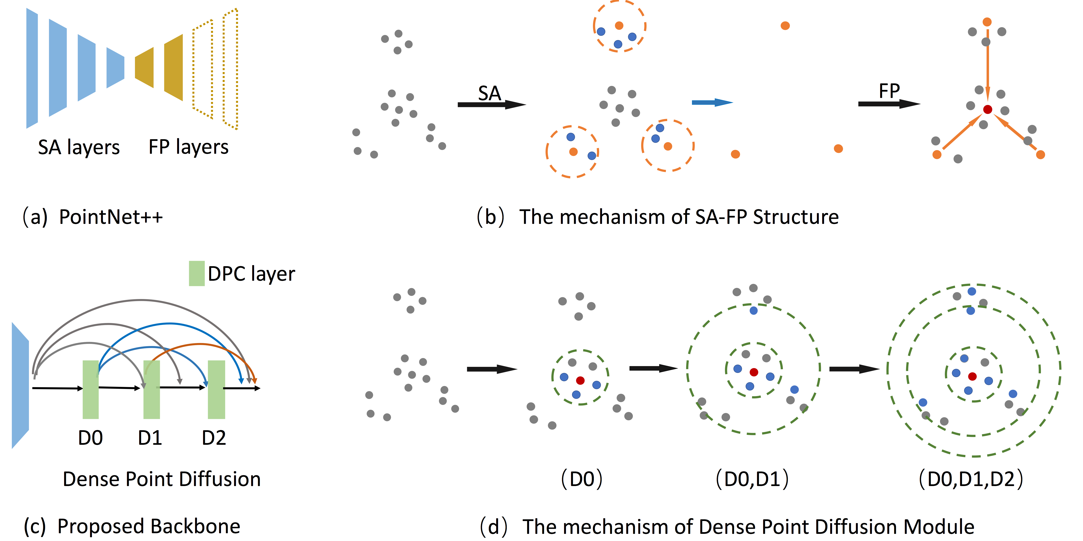
Dense Point Diffusion for 3D Object Detection
Xu Liu¹, Jiayan Cao², Qianqian Bi², Jian Wang³, Boxin Shi⁴, Yichen Wei²
¹The Univ. of Tokyo, ²Megvii Research Shanghai, ³Snap Inc., ⁴Peking Univ.
Motivation
Method
Experiments
We propose proposes Dense Point Diffusion module, a novel backbone network that solves the balance for large receptive field and point resolution. It adopts dilated point convolution as a building block to enlarge the receptive field and retain the point resolution at the same time. Further, a number of such layers are densely connected, giving rise to large receptive field and multi-scale feature fusion, which are effective for object detection task.
Dilated Point Convolution
In contrast with conventional point convolution, which choose the k nearest points, we enlarge the receptive field by choosing the nearest d-th, 2d-th,..., kd-th candidates within the radius of neighborhood and denote this as Dilated Point Convolution.
Our method can yield larger receptive field, denser sampling when more stages are involved .
Dense Point Diffusion Module
Ablation studies w.r.t. seed layer, stage
This method can represent multi-scale features efficiently by utilizing only a limited choice of dilated point convolution operators and then reuse the dilated convolution feature .this module progressively concatenates features from the previous stages and feeds them to the next stage of Dilated Point Convolution, generating features with larger receptive field. In the parallel direction, the concatenation operator aggregates features inclusively from each of the previous layers, covering a wider range of scales. The concatenated features are set as the output of the module and are formulated as following,
Contributions
To better build the backbone network for 3D obhect detection
We introduced dilated point operator to resolve the balance
and large receptive field and point resolution.
We introduce our module that can quickly increasing receptive
field size, multi-scale fusion,and dense feature sampling,
Our method surpasses the conventional PointNet++.
across the board.
$$∙$$
$$∙$$
The quantitative result on SUN-RGBD, evaluated with mAP@ 0.25.
$$∙$$
Intuition
Comparison with Point Diffusion Module
The quantitative result on ScanNet, evaluated with mAP@ 0.25.
The quantitative result on ScanNet, evaluated with mAP@ 0.5.
For PointNet++, the receptive field of points is enlarged, but the point resolution is reduced. FP operator recover the point resolution by coarse interpolation, which will bring sub-optimal results to 3D object detection. Our method can avoid the above problems.
Our dense module has larger receptive field but also can cover wider range of scales compared with the vanilla version .

