Slide 1
Group Contextual Encoding for 3D Point Clouds
Xu Liu^{1,2}, Chengtao Li³, Jian Wang⁴, Jingbo Wang⁵, Boxin Shi⁶, Xiaodong He²
¹The University of Tokyo, ²JD AI Research, ³MIT, ⁴Snap Inc, ⁵CUHK, ⁶Peking University
Support: GCL, MEXT, BAAI, JD AI& Cloud Group

Slide 2
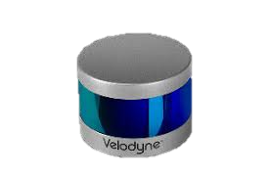
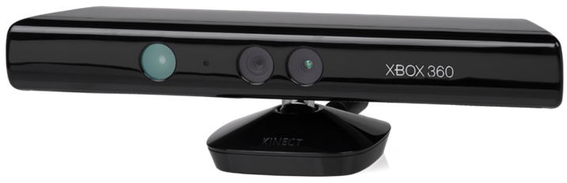
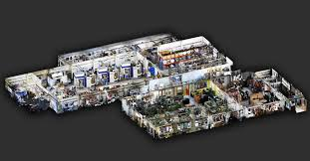
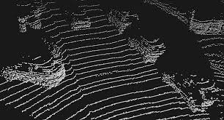
Point Clouds from 3D Sensors
Microsoft Kinect I by structured light
Velodyne LiDAR by time of flight
Point clouds of indoor scene
Points cloud of outdoor scene
Notes:
Point clouds data are acquired by typical 3D sensors such as Kinect depth camera and velodyne LiDAR

Slide 3
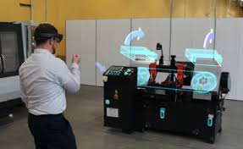
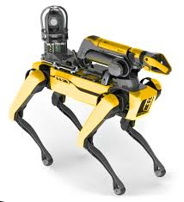
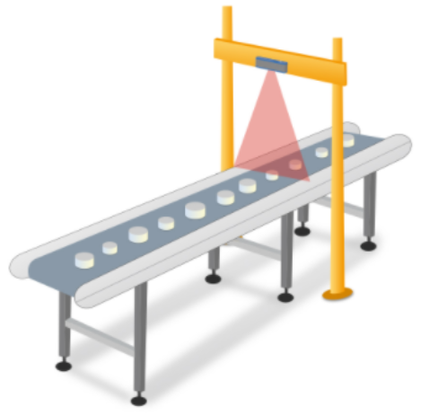
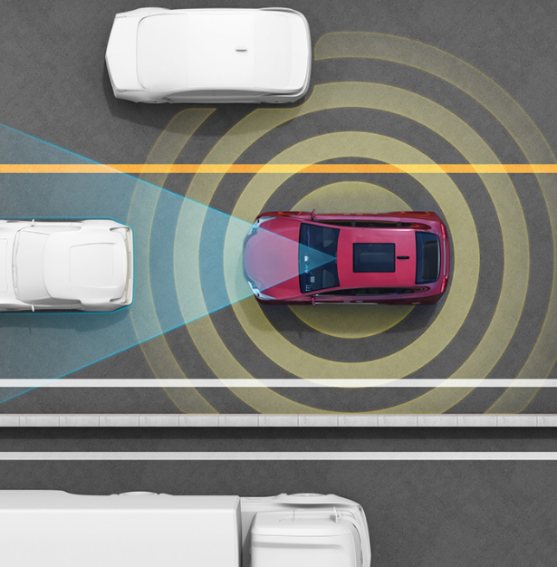
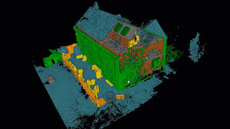
Applications for 3D Point Clouds
Augmented reality
Authentica-tion
Indoor
robots
Point Clouds
Industrial automation
Autonomous cars
Real Estate
Notes:
The 3D point clouds data can be utilized to support various fields such as autonomous driving, Robotics as well as AR.

Slide 4
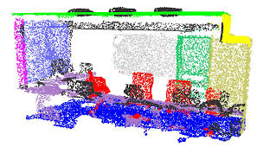
The data-sparsity in 3D Point Clouds
Compared to 2D scenarios, data-sparsity becomes a major issue in 3D point cloud scenarios. Notice the holes in the figure.
Present great new challenges.
4

Slide 5
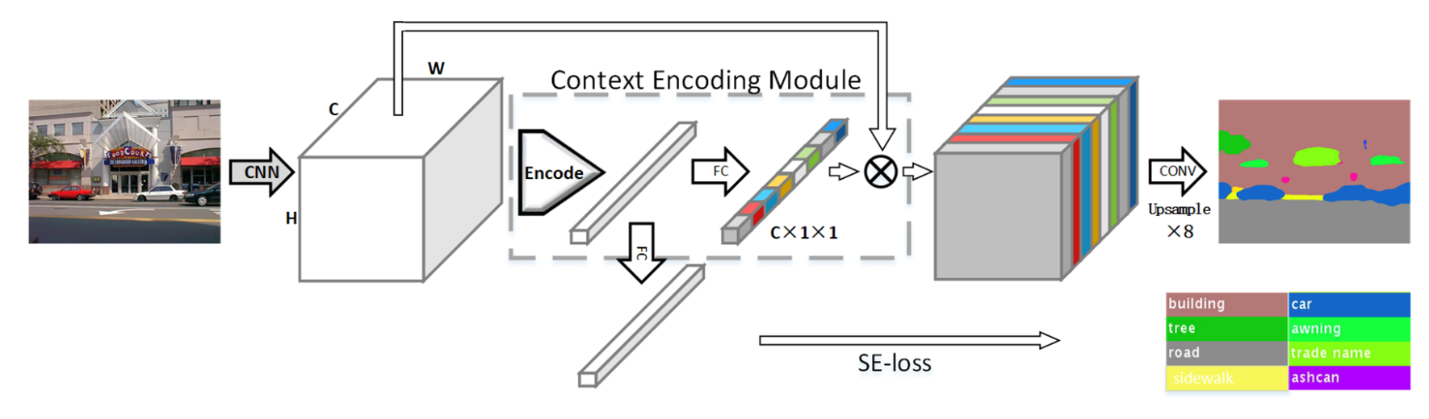
Contextual Encoding in 2D
Global context is beneficial for visual recognition.
[Zhang et al. , 2018]
O(N) in complexity, efficient method for global context
How to extend the idea to the 3D scenarios?
Notes:
Global context is beneficial for visual recognition
Among these methods, encoding layer is efficient because it is linear function of the input size.
So what will happen if it is extended to 3D point scenarios?

Slide 6
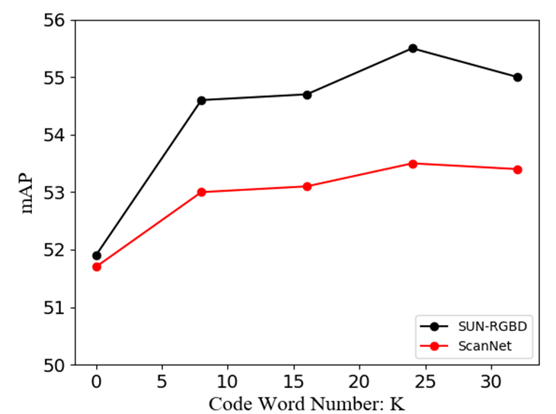
Contextual Encoding in 3D?
Problem of Encoding Layer
Performance saturates quickly with the code number
due to data-sparsity, which causes overfitting.
Notes:
According to the experimental results in the table,
Performance saturates quickly with the code number
due to data-sparsity, which causes overfitting. This will prevent
From gaining better performance.

Slide 7
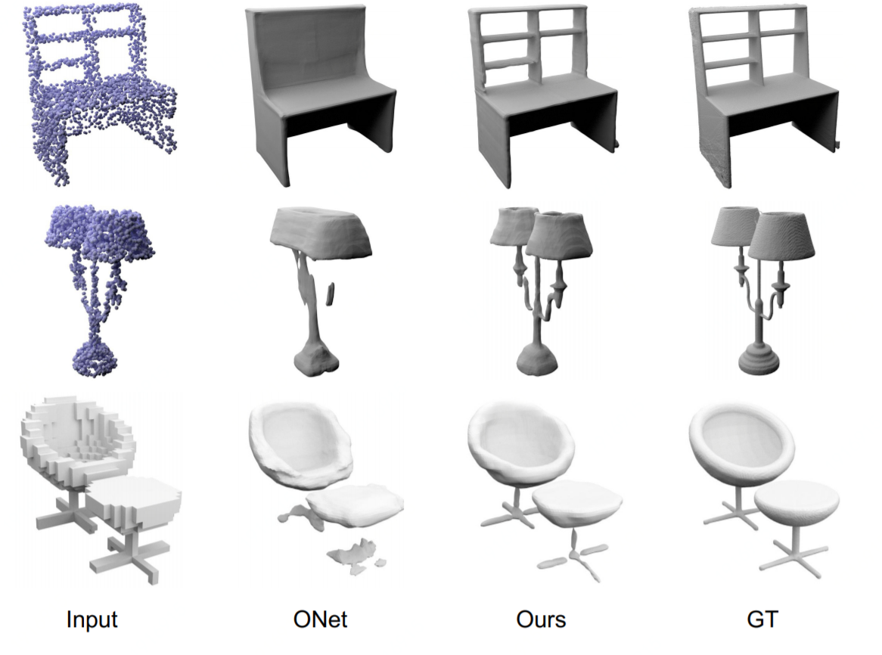
How to solve data-sparsity?
Convolutional Occupancy Networks.[Peng et al. , 2020]
Depth Completion methods are inherently computationally expensive and complex in structures.
Any simple and computationally efficient method?
Notes:
How to deal with this issue?
Depth Completion methods can be used to attack this issue, but it is inherently computationally expensive and complex in structures.
Is there any computationally efficient methods?

Slide 8
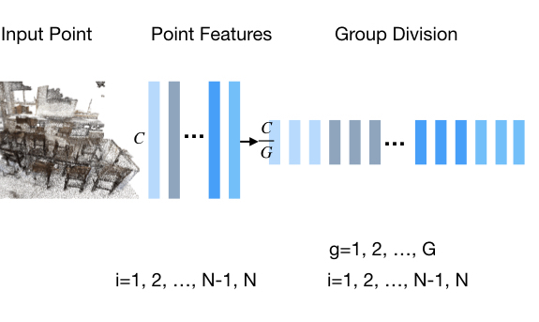
How to solve data-sparsity?
Our Method: Group Division
Divide channels into G groups, and
the number of points is then augmented by G.
Data is densified
simple and efficient
Notes:
By dividing the channels into groups, the number of points is then augmented, the method is simple and efficient.

Slide 9
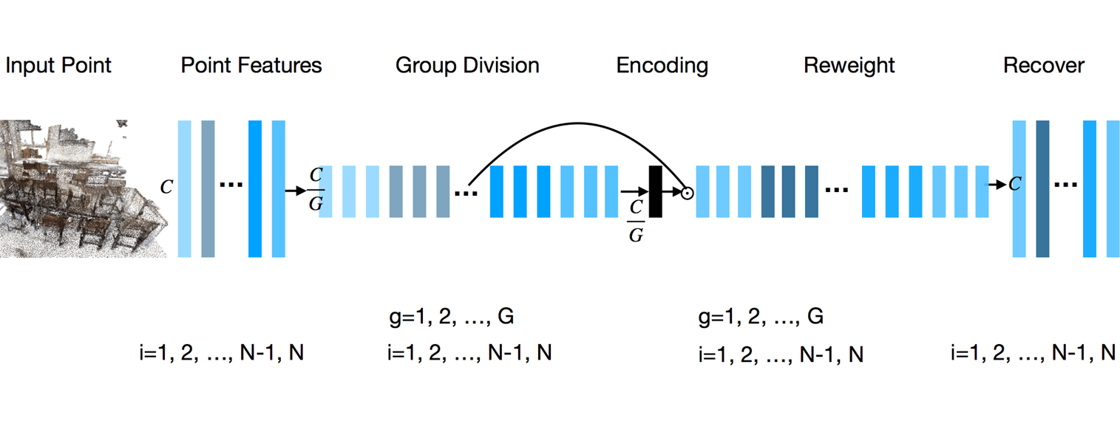
Contextual Encoding in 3D?
Our Method – Group Contextual Encoding
Facilitate learning global context in grouped subspace
Notes:
Here is our method of group contextual encoding,

Slide 10
Result on ScanNet
Comparison with SOTA methods, evaluated with mAP@0.25
Comparison with SOTA methods, evaluated with mAP@0.5
Our method is 6.57 mAP better than VoteNet on mAP@0.5

Slide 11
Ablation Studies
Channel Number
Encoding Method
Grouping Method
Notes:
This is a scene being imaged by a conventional camera ---- each scene point gets mapped to a single pixel, and we get a sharp image. But, with a cylindrical lens, a whole column of scene points will be mapped to a scene point --- so, each pixel just captures the 1D integral of this conventional image. This is an important point – so, I will repeat --- with a cylindrical lens, each pixel integrates light along a collection of rays, or a plane…
So, let’s go back to our structured light setup…

Slide 12
Result on SUN-RGBD

Slide 13
Qualitative Results
(a) SUN-RGBD
(b) ScanNet

Slide 14
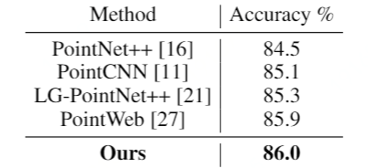
Result on ScanNet Voxel Labeling
Comparison with SOTA methods
Surpassing previous state-of-the-art methods
Notes:
Cylindrical lens ---- it spreads light out in one direction. Show a photo of a linear diffuser here on top ---- spreads light out in one direction.
Now, the next observation is that projector and camera are really the same device geometrically – sure, projector emits light and camera captures light, but the geometric mapping between the 3D world and 2D world is the same. So, we can simply replace the projector with the camera and vice versa….

Slide 15
Conclusion
Group Contextual Encoding: a simple method to solve the data-sparsity and facilitate learning global context for
3D point clouds
https://github.com/AsahiLiu/PointDetectron
NeurIPS 2020 Poster ID: 540

