Slide 1
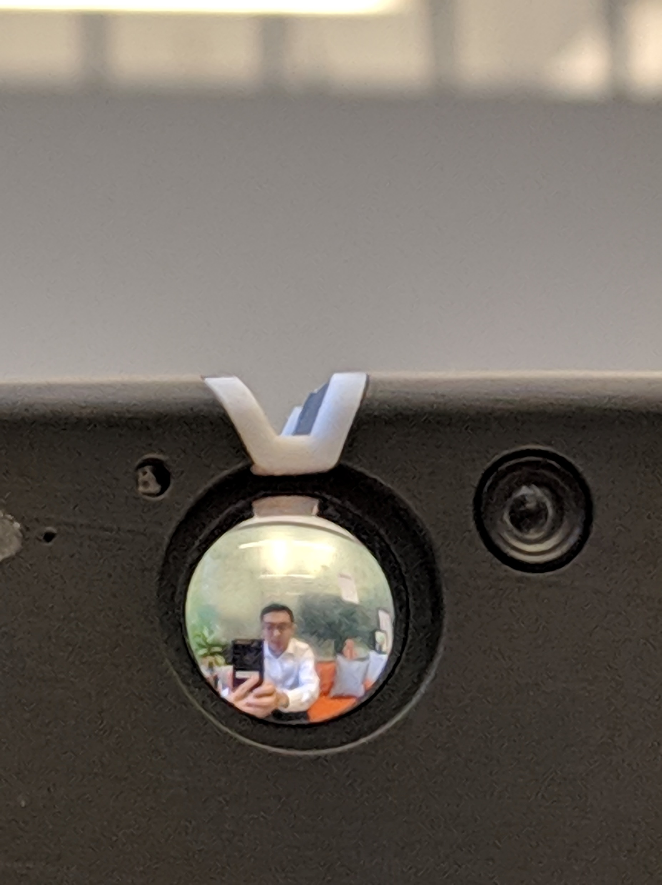
Mirror
Viewfinder
Back Camera
The goal is
the FOV of the Back Camera should be equal to the view (reflection) in the Mirror Viewfinder.

Slide 2
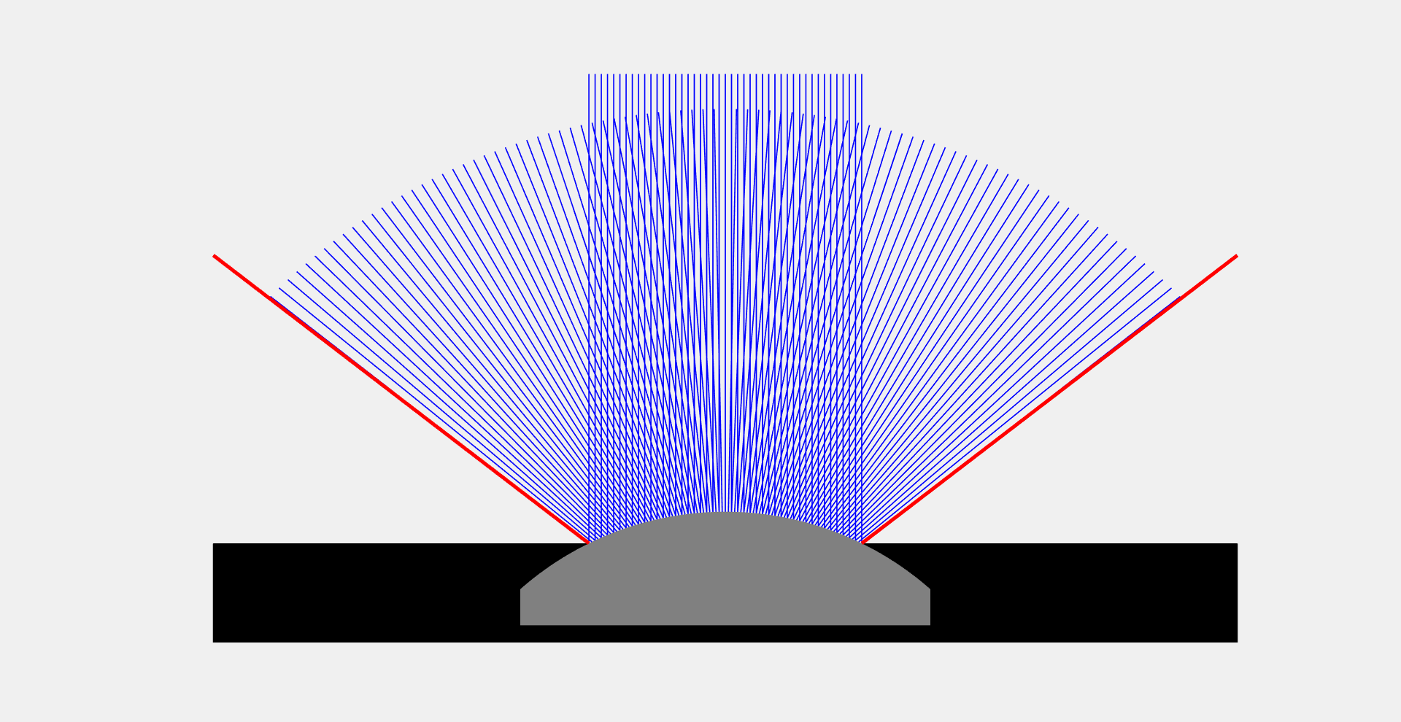
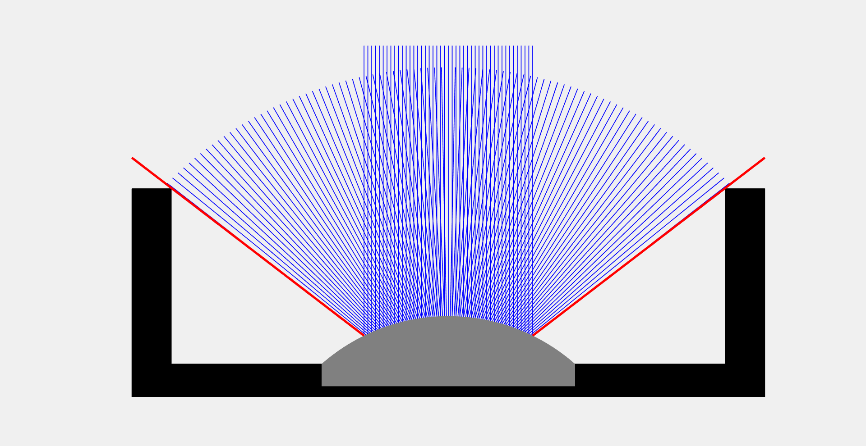
Naïve design
Our design

Slide 3
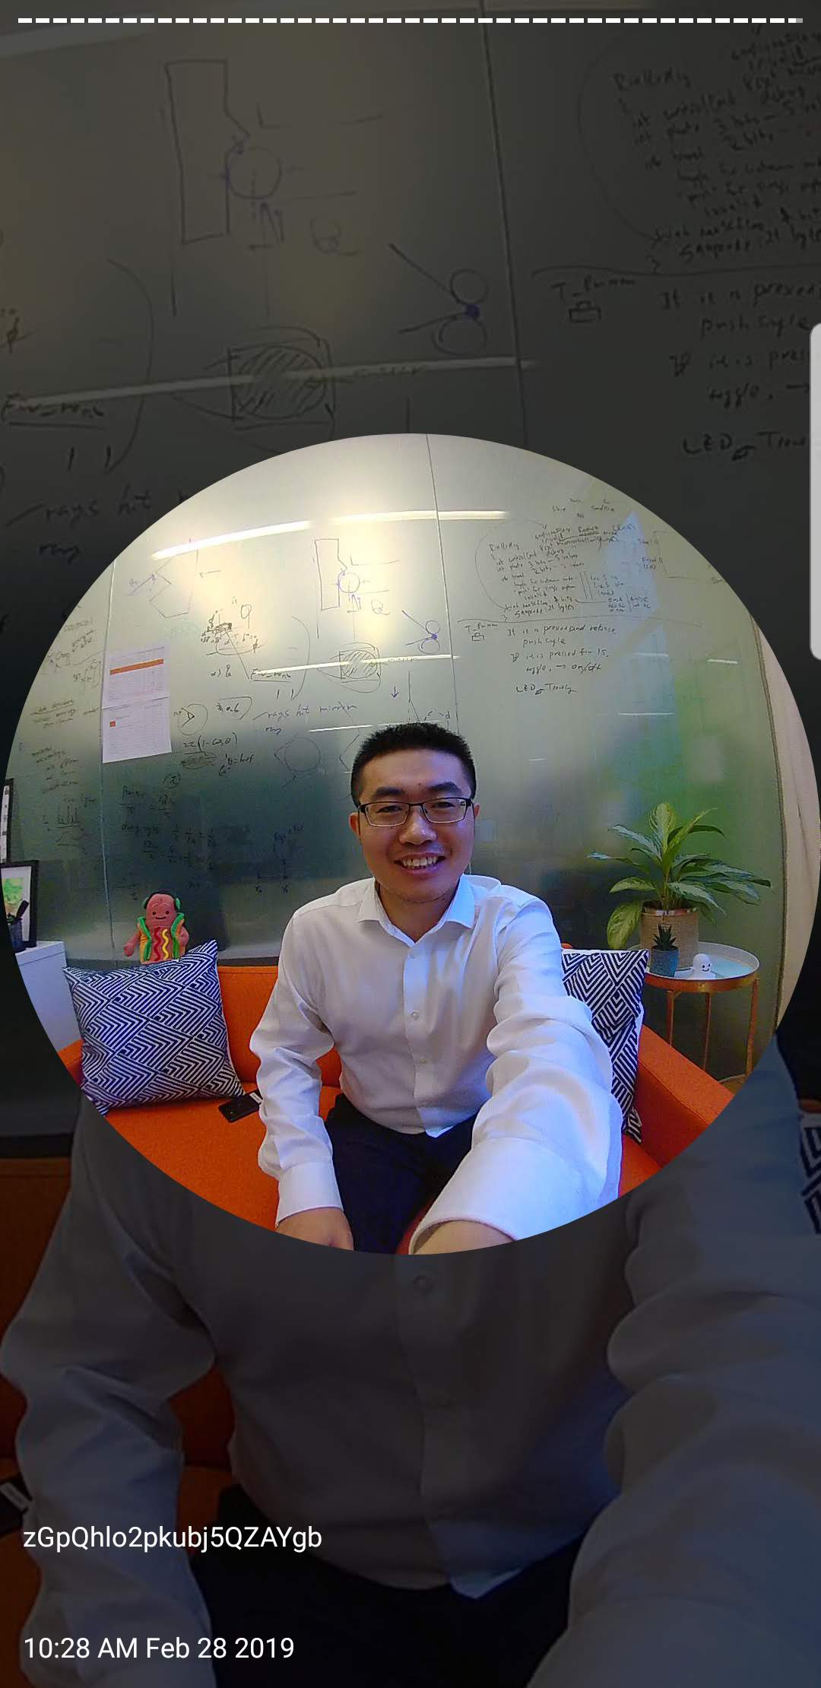
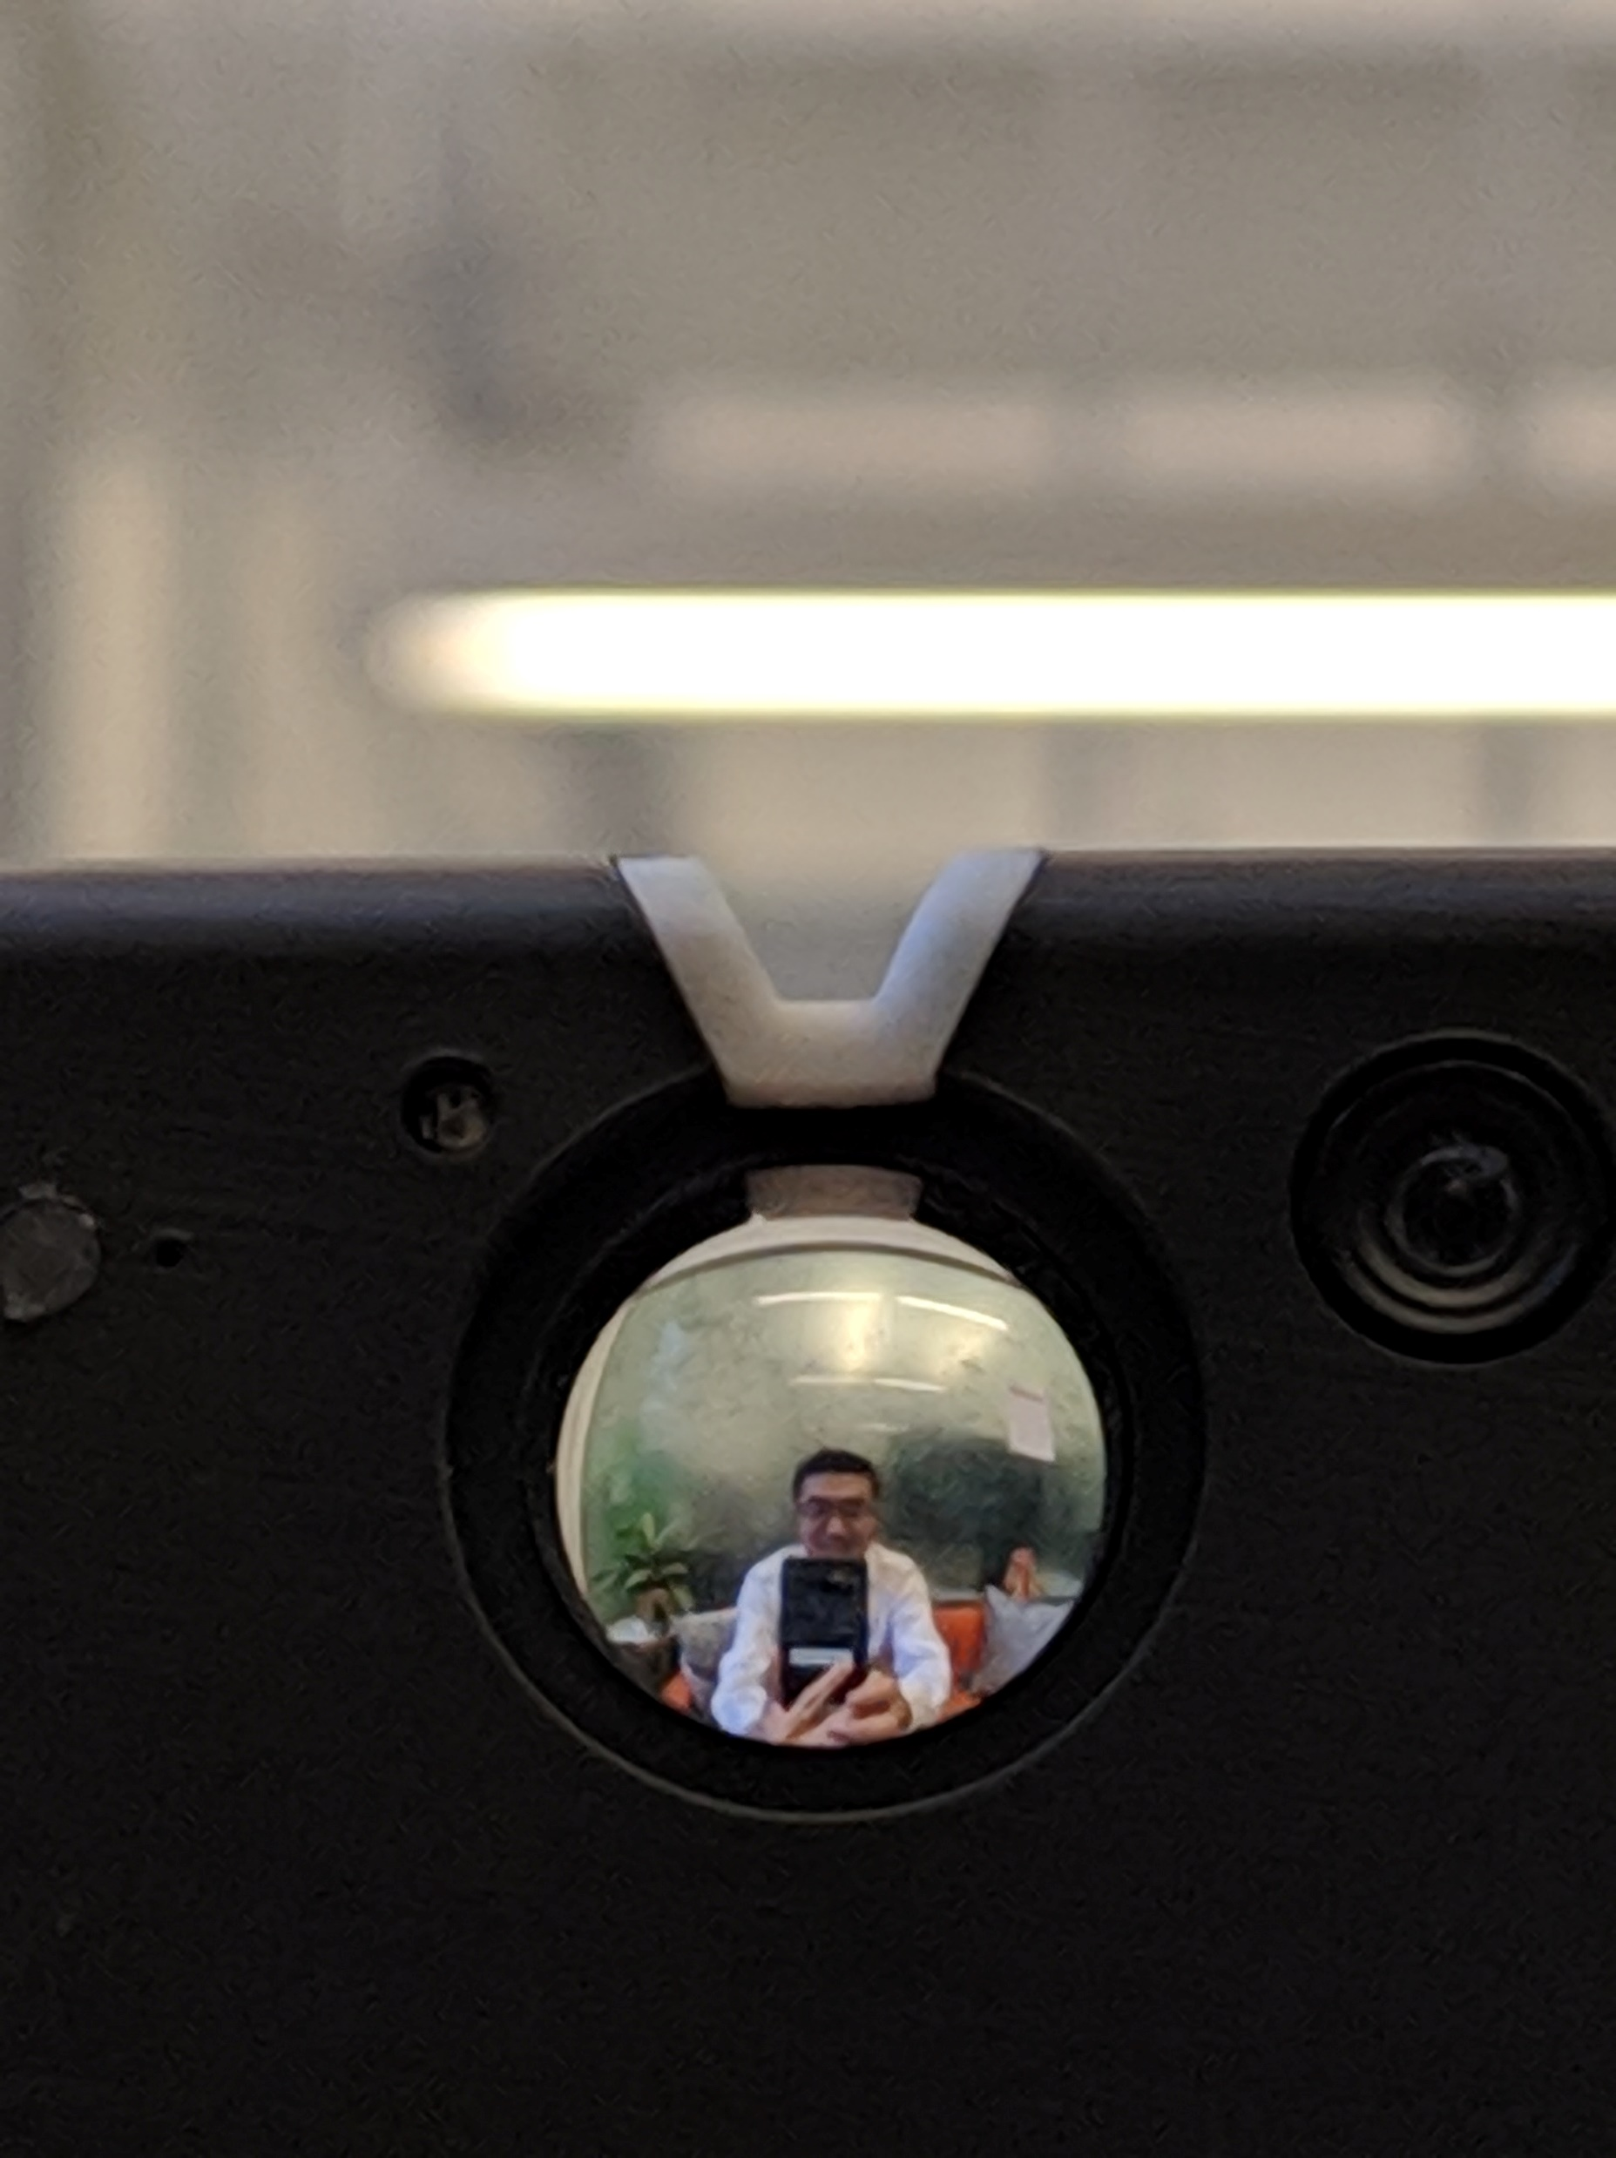
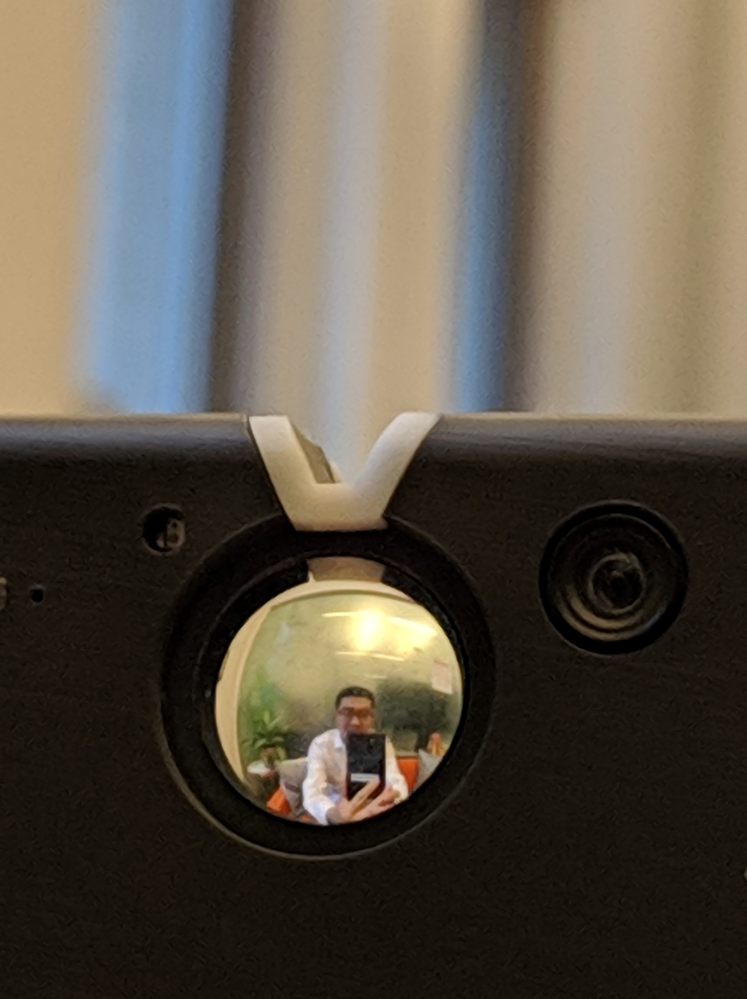
Mirror
viewfinder
Camera
Viewing angle = 0 deg.
Viewing angle = 20 deg.
Viewing angle = -20 deg.
By mirror viewfinder
By camera

Slide 4
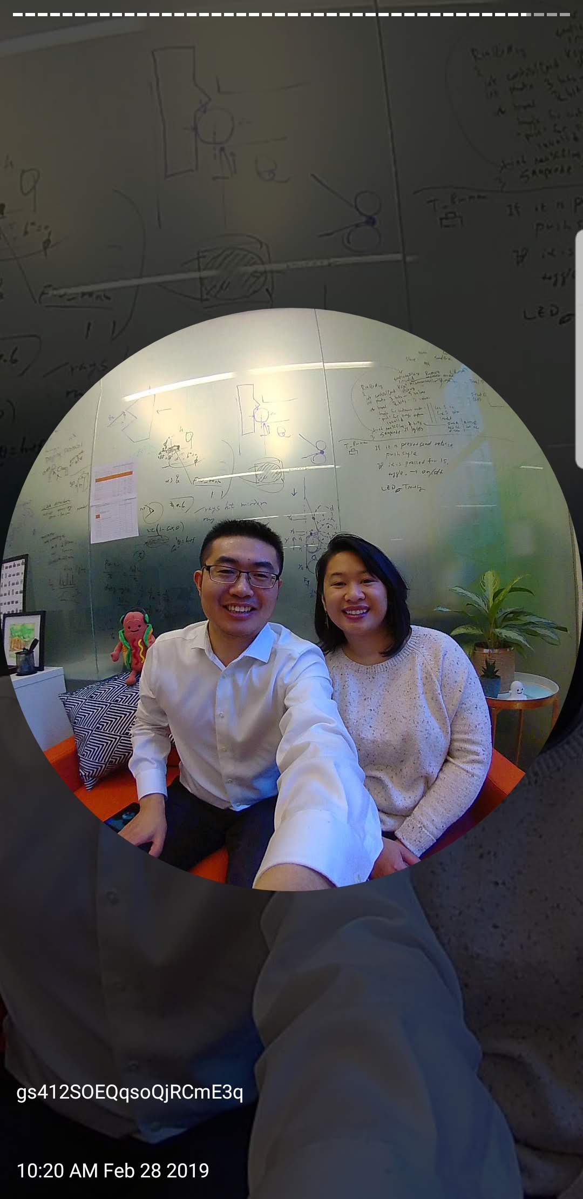
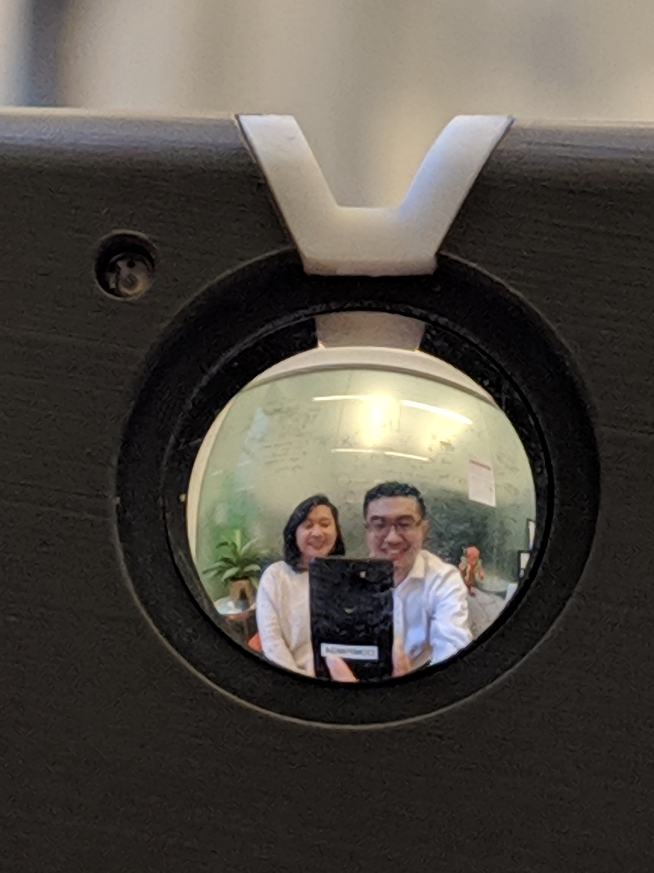
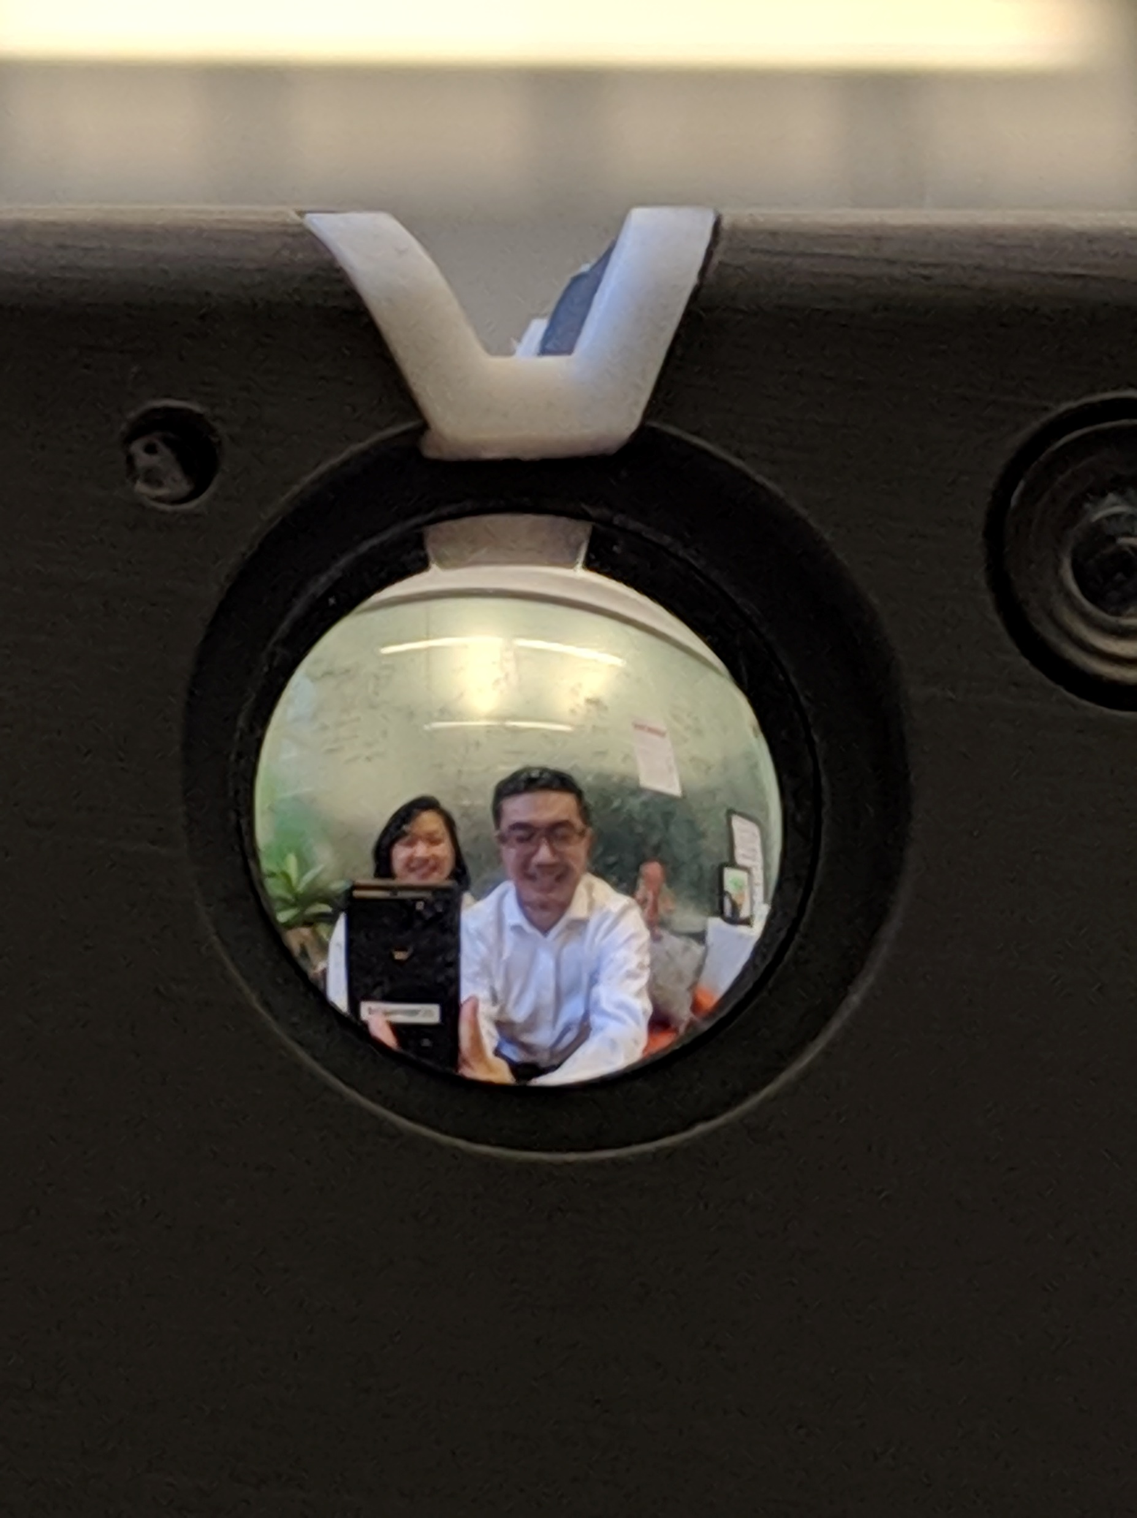
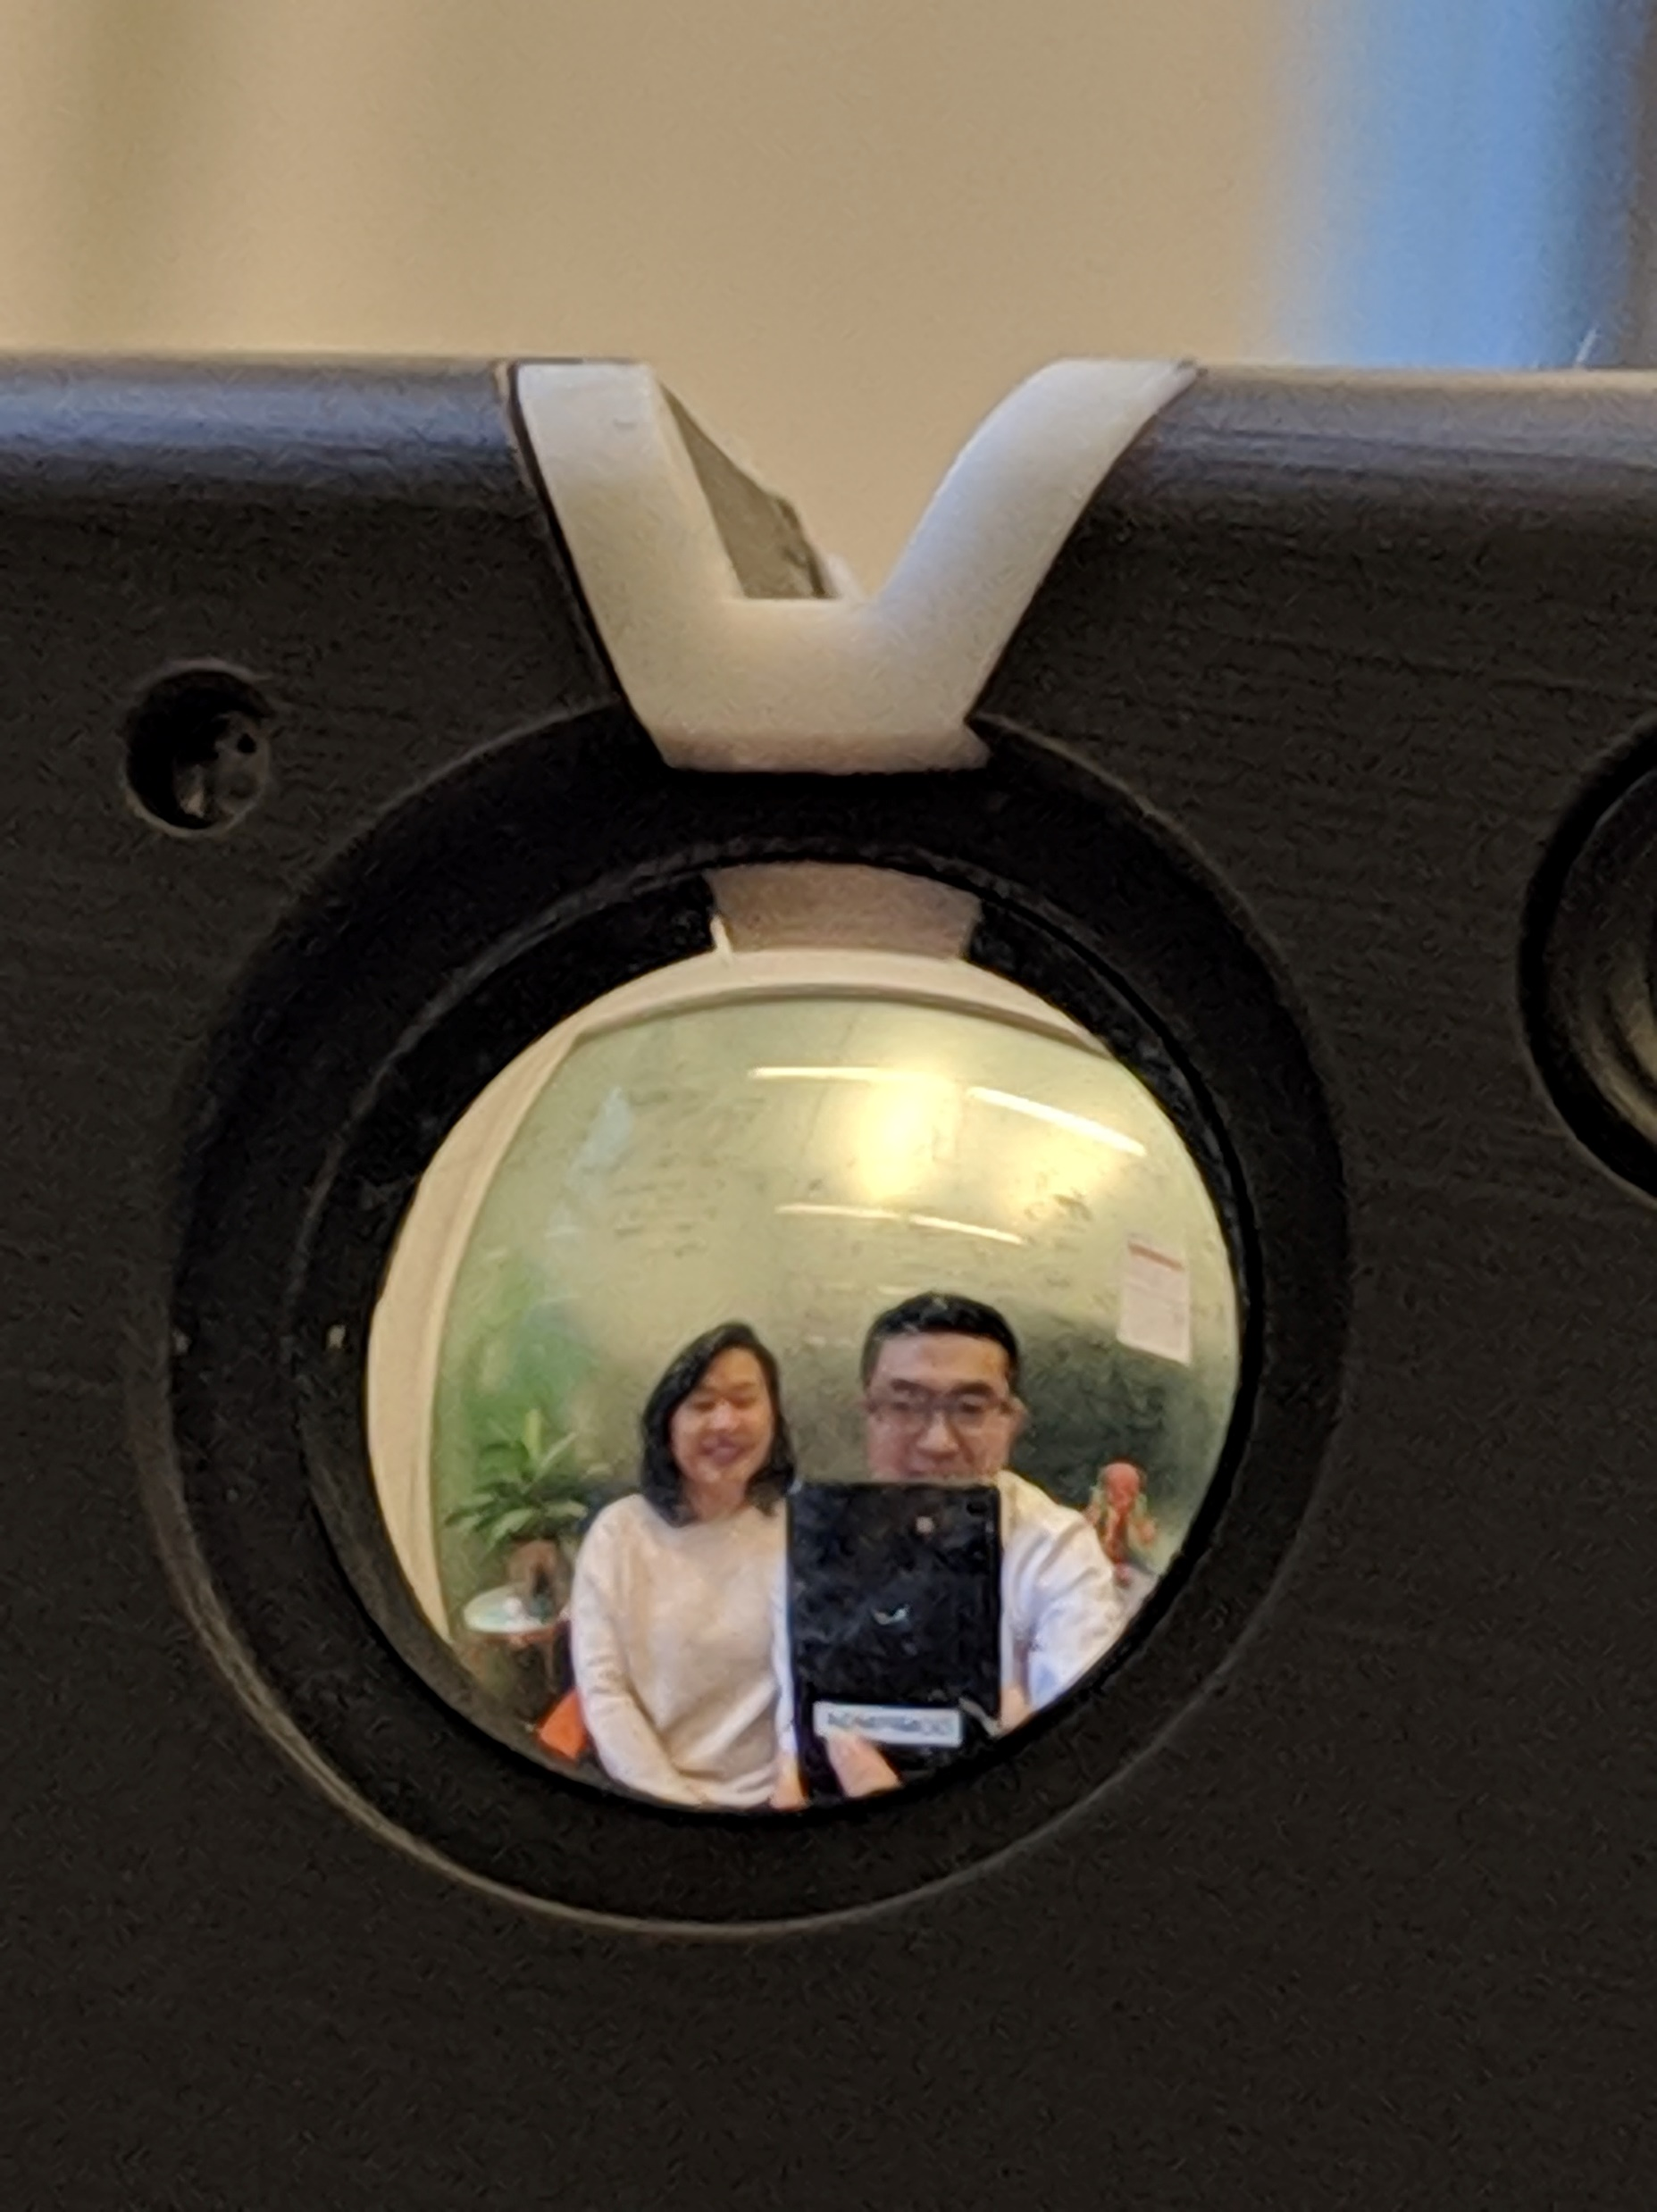
Viewing angle = 0 deg.
Viewing angle = 20 deg.
Viewing angle = -20 deg.
By mirror viewfinder
By camera

